Slide 1
Edge Fundamentals Bootcamp
Anatomy of an Edge Proxy

Slide 2
Anatomy of API Proxy
Discussion
Explore the main logical components of the EDGE system from an Administrator's perspective
Review Platform Entities
Organizations, Environments and Proxies
Proxy Endpoint
FaultRules
Virtual Hosts
Flows
PreFlow
Conditional Flow
PostFlow
Connection
RouteRules
Target Endpoint
FaultRules
Flows
PreFlow
Conditional Flow
PostFlow
Connection
LoadBalancer

Slide 3
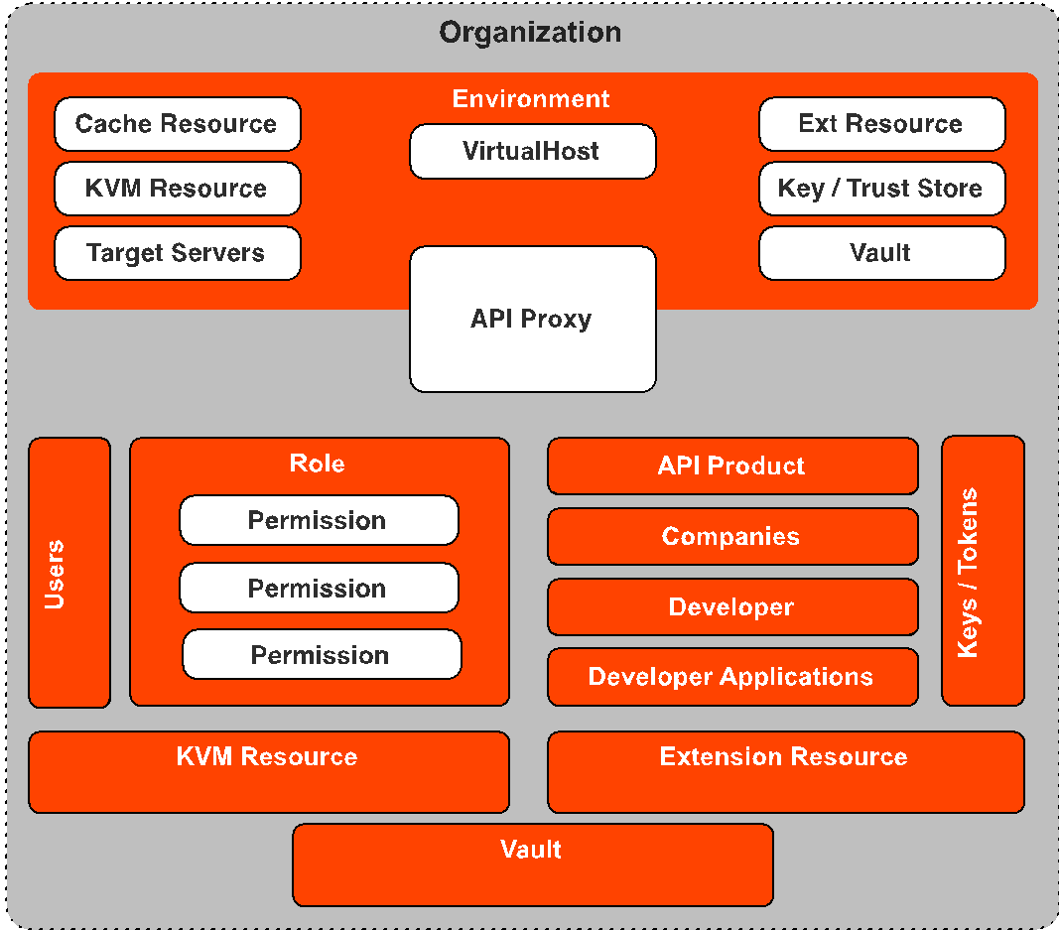
Platform Entities
Notes:
But Before we dive into the anatomy of an API Proxy we need to understand where proxies live on the platform.
The Edge platform is a built as a multi-tenet platform that hosts in the cloud or a Private cloud a customer proxy platform. That Platform is made of some core components.
First Component of Note: Organization
Organizations are important because they define the platform. Every other component lives either directly in an organization or in a component that lives in an organization. Organizations ultimitly give you a logical barrier around your platform logical components. No two organizations share logic components.
\ Now lets go over the organizations components:
Environments live withen organizations and are primariliy used to managed the deployed state of your proxy. For instance if i had a test, prod environment i could deploy my proxy to either or both environments. Environments may contain a series of resources that are used by your proxy. eg. Virtual Hosts, Target Servers, Cache Resources, Extension Resources, KeyStore's and Trustores and Vault.
Also living at the Organization level is all of the user management elements used to manage access to resources. User management is composed of three components starting with Users whole are assigned a Role (the second) which contains a series of Permissions.
API management is a key focus for an apiproxy and the resources needed for API management are stored at the Organization level, for instance API Products ,Companies, Developers and Developer Applications. And because of this keys and tokens are also stored within the orgaization.
Note: Although they API products are stored at the organization, they can be scoped to a particular environment or API Proxy.
Discussion Notes: This topic often leads to Organization vs. Environment stratagies
Also like the environment KVM Resources, Extension Resources and Vaults can also be stored at the organization level.

Slide 4
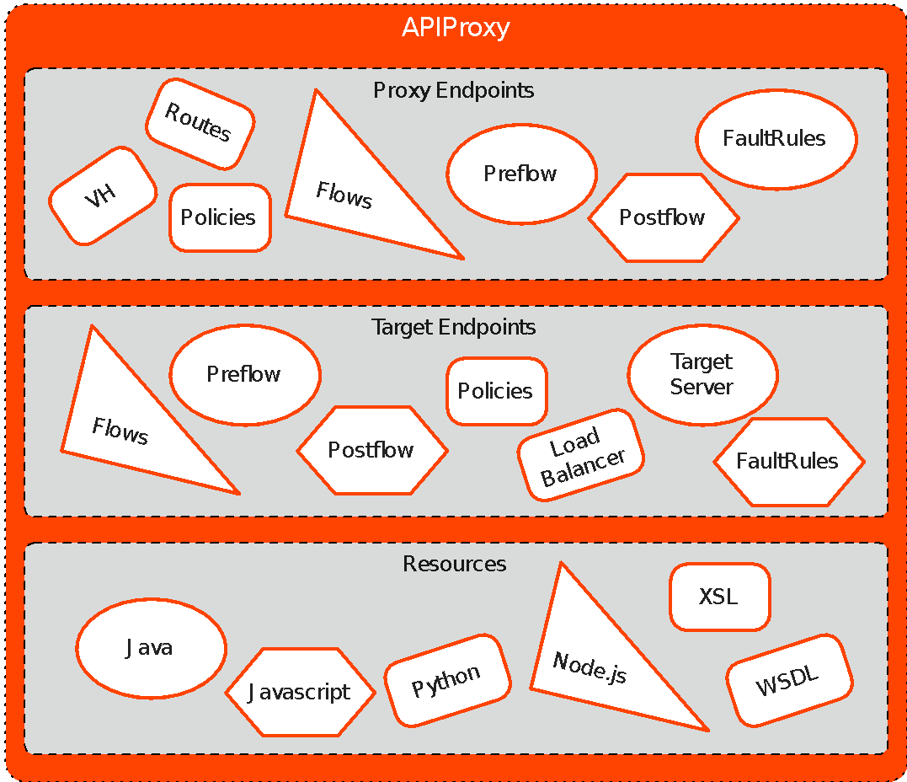
API Proxies
Notes:
An Api Proxy is composed of 3 primary components
The First is the Proxy Endpoint
The second is the Target Endpoint
Third is your Scripting Resources
Now lets break each one of these components into their separate parts

Slide 5
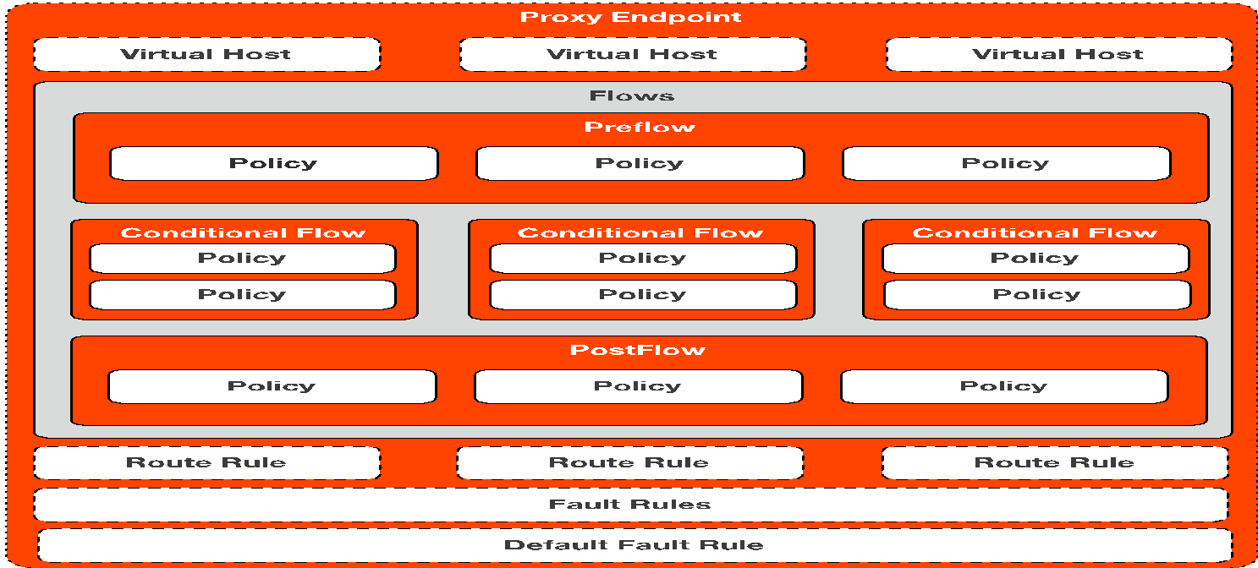
Proxy Endpoint

Slide 6
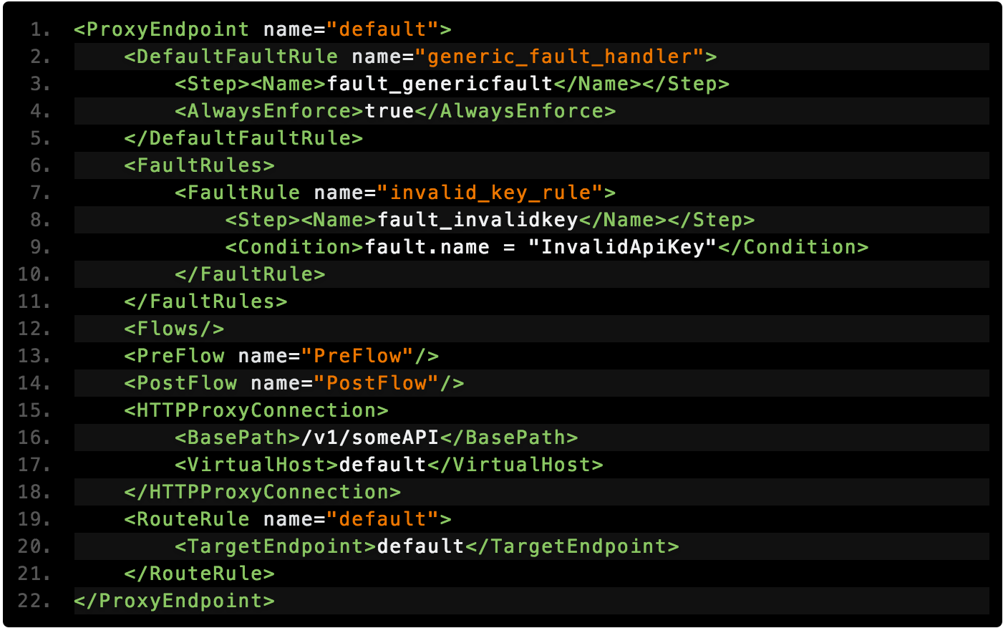
Proxy Endpoint Example
Notes:
Lets look at what a proxy looks like in a simple form. One of the key configuration points for your proxy resides in the HTTP Connection tag, were we configure the base path and the virtual hosts. The basepath is very important since it needs to be unique across all your proxies When building you proxy there is not specific order the root level tags need to be in. Some advise would be to keep a consistant order. Like this example I typically order the root level tags starting with the Fault Rules and Default fault rules Then the Preflow, Flows, Postflow tags. Then the HTTP Connection tag and then I close with the Route Rules.

Slide 7
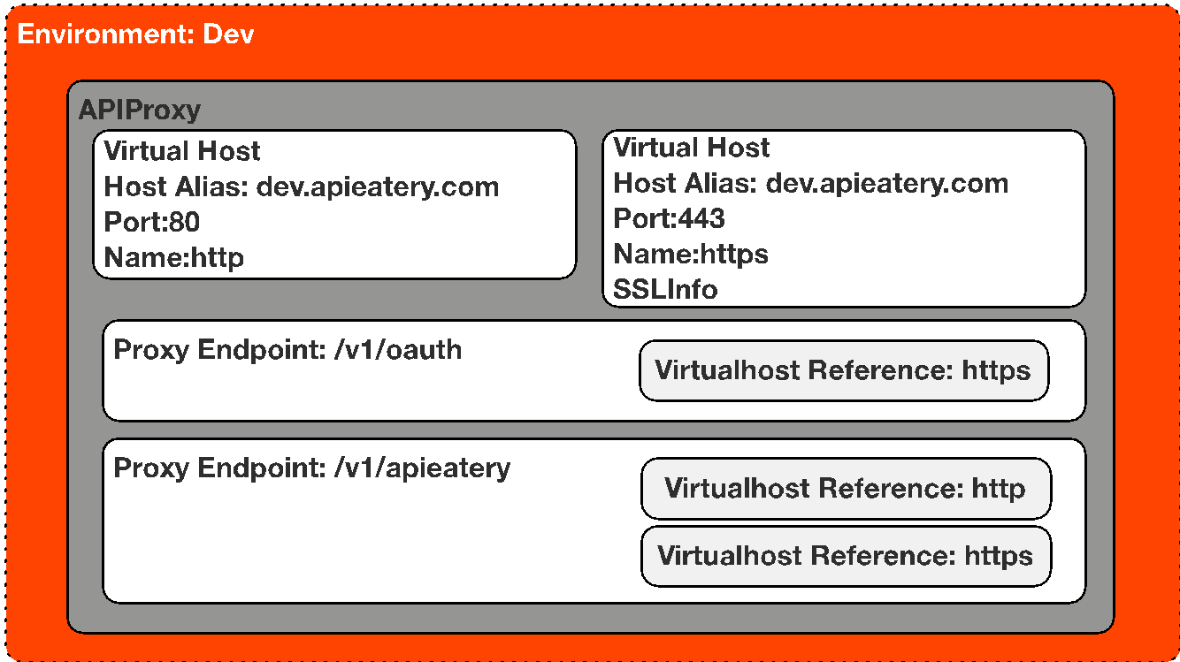
Virtual Hosts
Notes:
Virtual hosts let multiple domain names connect to the same host. A virtual host on Edge defines the domains and Edge Router ports on which an API proxy is exposed, and, by extension, the URL that apps use to access an API proxy. A virtual host also defines whether the API proxy is accessed by using the HTTP protocol, or by the encrypted HTTPS protocol.
A environment can contain multiple virtual hosts and a proxy’s client side endpoint is configured to listen on one or more virtual hosts. The virtual host’s configuration determines how an API request will route into an API proxy
Edge classifies requests using the following: Virtual Host Port, Request’s Host Alias (value of Host header), Proxy Endpoint BasePath
----- Meeting Notes (2/9/16 13:54) -----
Virtual Host configs should live outside of the API proxy

Slide 8
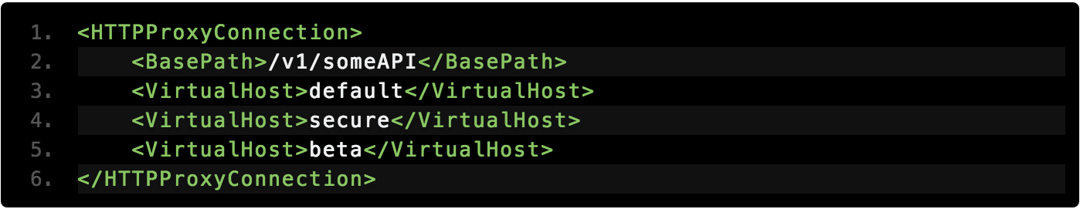
Virtual Hosts

Slide 9
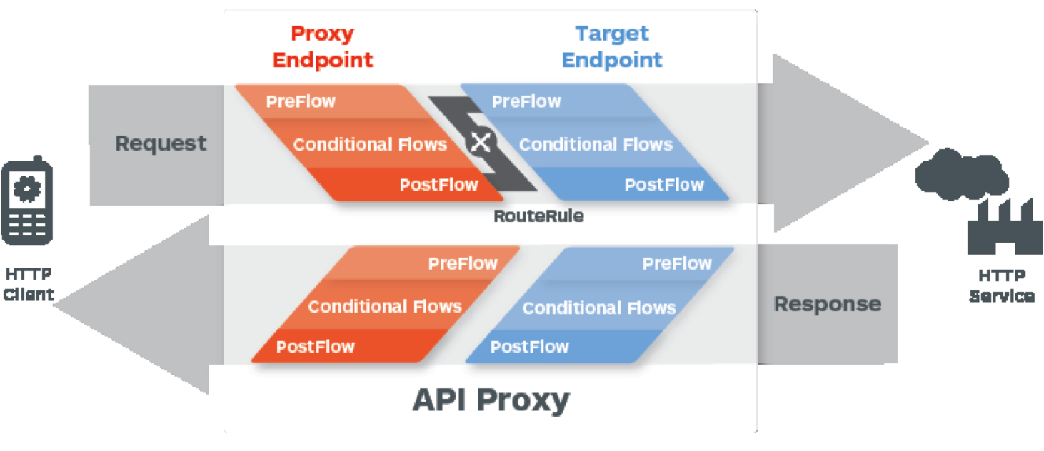
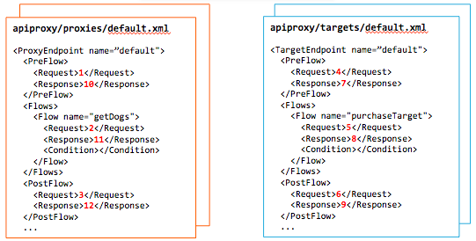
Policy Flows
1
4
2
5
3
6
10
7
11
8
12
9
13
Notes:
“Policies” are steps within the API Flow. The Proxy Endpoint contains policies that affect the request and response to the Client. The Target Endpoint contains policies that affect the request and response to the backend Target server PreFlow: Always executes before any conditional Flows. Conditional Flows: One or more Flows, each of which has an associated Condition. Only one Flow executes per transaction--the first Flow whose Condition evaluates to true. PostFlow: Always executes after any conditional Flows. PostClientFlow: An optional Flow that executes after the response message has been sent to the requesting client app. (This is a specialized Flow, and only MessageLogging policies can be attached to it.)

Slide 10
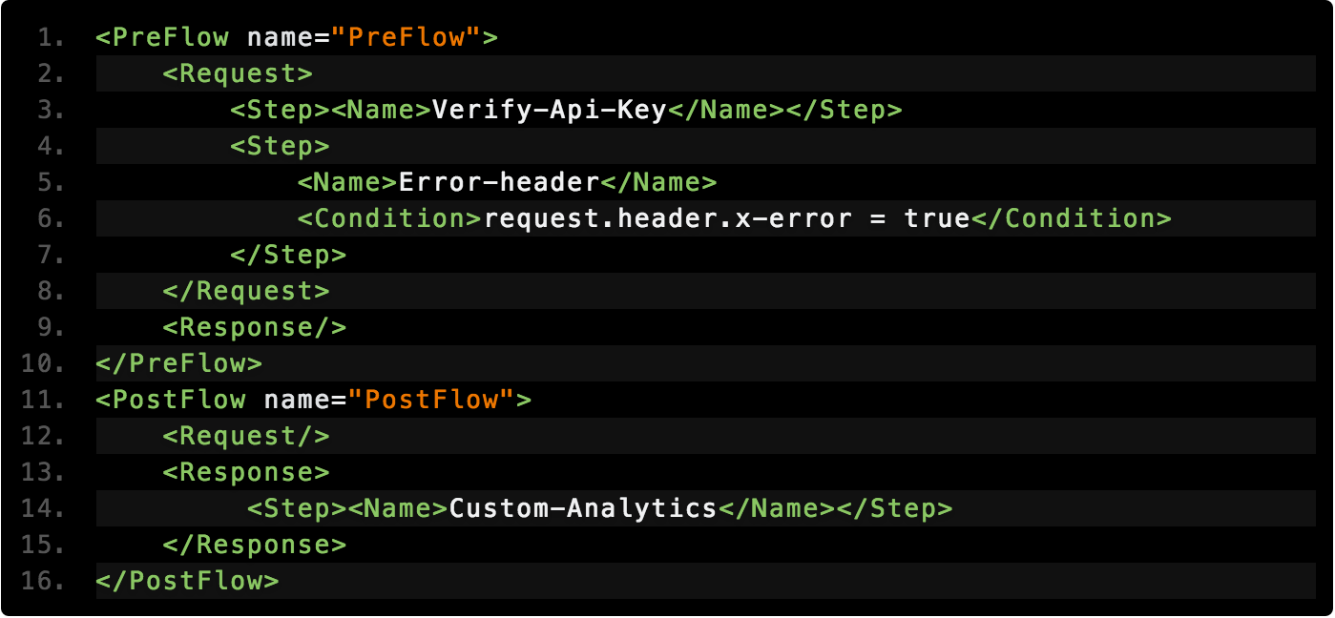
Policy Flows
Global Flows
Notes:
Walkthrough the structure of the XML Spend a little time talking about PostClientFlow.. And make sure you mention that only Message Logging Policies can be executed in that flow.

Slide 11
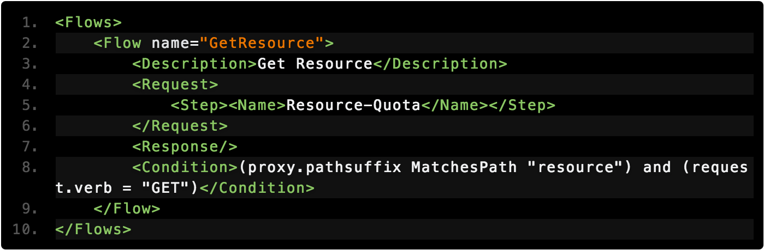
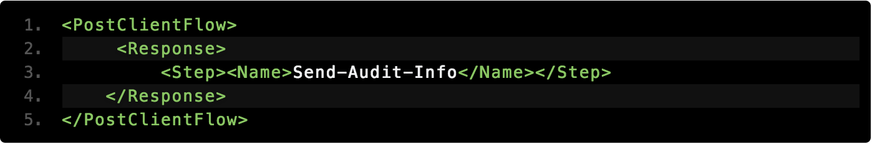
Policy Flows
Conditional Flows / Resource
Post Client
Notes:
A “Conditional Flow” is a collection of policies within the API Flow that all share one rule. All policy attachments in the Preflow execute first, then the first matching Conditional Flow execute, then everything in the Postflow executes. This happens on the Proxy Request, then the Target Request, and repeats back through the Target Response and the Proxy Response.
There are a couple of ways to add resource via the UI show some examples of using said methods show the viewers how to view the new resources via the develop pain.

Slide 12
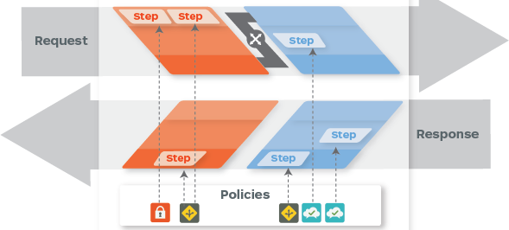
Policies
Notes:
Edge enables you to 'program' API behavior without writing any code, by using 'policies'. A policy is like a module that implements a specific, limited management function. Policies are designed to let you add common types of management capabilities to an API easily and reliably. Policies provide features like security, rate-limiting, transformation, and mediation capabilities, saving you from having to code and maintain this functionality on your own. Edge Policy types are grouped into the following functional categories: Traffic management Policies in the traffic management category enable you to control the flow of request and response messages through an API proxy. These policies support both operational- and business-level control. They give you control over raw throughput, and can also control traffic on a per-app basis. Traffic management policy types enable you to enforce quotas, and they also help you to mitigate denial of service attacks. Mediation Policies in the mediation category enable you to actively manipulate messages as they flow through API proxies. They enable you to transform message formats, from XML to JSON (and vice-versa), or to transform one XML format to another XML format. They also enable you to parse messages, to generate new messages and to change values on outbound messages. Mediation policies also interact with basic services exposed by API Services, enabling you to retrieve data about apps, developers, security tokens, and API products at runtime. Security Policies in the security category support authentication, authorization, as well as content-based security. Extension Policies in the extension category enable you to tap into the extensibility of API Services to implement custom behavior in the programming language of you choice. Each Policy type is documented in detail in the Policy reference overview. This topic demonstrates general interaction, showing you how to create Policies, and how to attach them to Flows in an API proxy configuration.

Slide 13
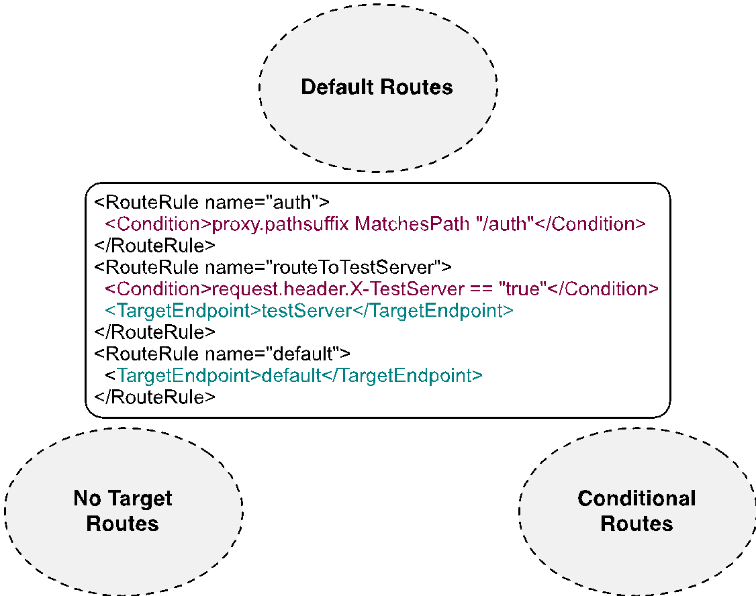
Route Rules
Notes:
Target is determined by RouteRules One or more RouteRule sections at the bottom of the proxy definition file (proxies/{proxy}.xml) within ProxyEndpoint RouteRules evaluated top to bottom, taking first match only TargetEndpoint is the name of the target file No TargetEndpoint means no target called (no Target Request and Target Response) No condition supplied means that RouteRule will automatically match

Slide 14
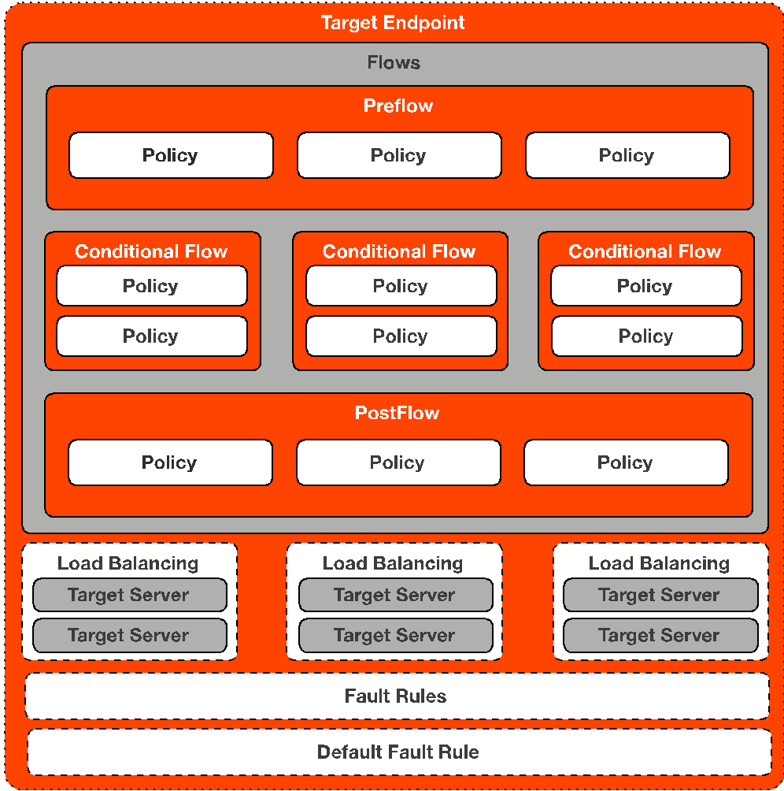
Target Endpoint
Notes:
Defines the way the API proxy interacts with your backend services. You configure the TargetEndpoint to forward requests to the proper backend service, including defining any security settings, HTTP or HTTPS protocol, and other connection information. You can attach policies to the TargetEndpoint to ensure that response messages are properly formatted for the app that made the initial request.
----- Meeting Notes (2/9/16 13:54) -----
Can you have multiple LBs within a single Target Endpoint??

Slide 15
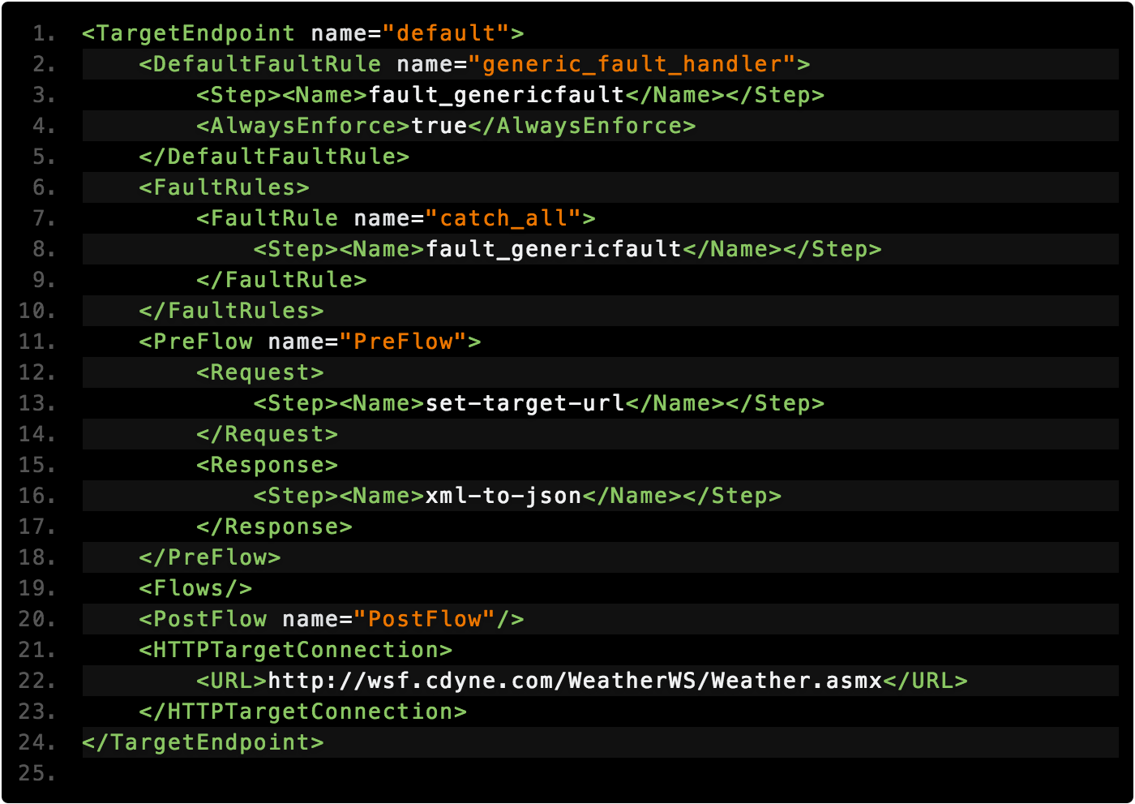
Target Endpoint Example
Notes:
Review The Target Endpoint's Basic Features, point out its basic structure and its similarities to the Proxy Endpoints

Slide 16
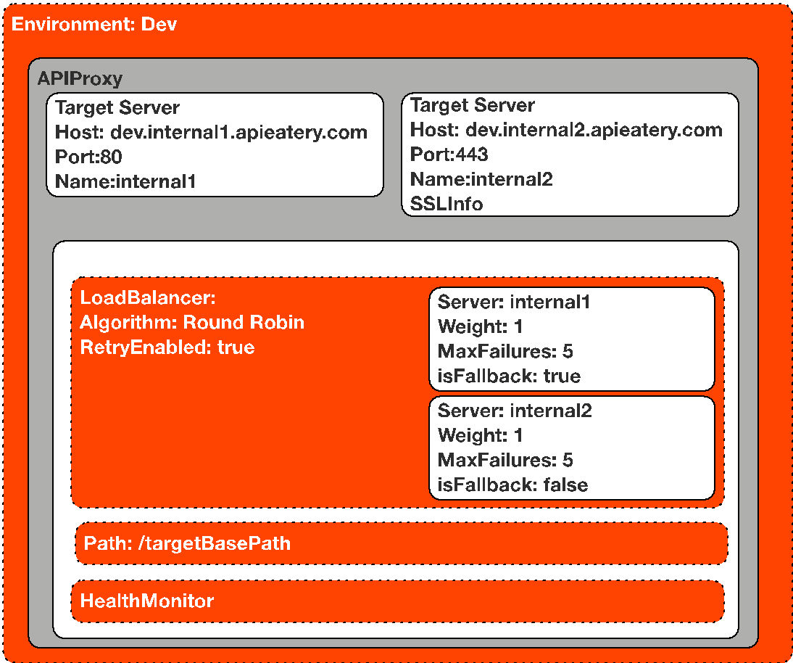
Load Balancing
Notes:
Edge enhances the availability of your API by providing built-in support for load balancing and failover across multiple backend server instances. TargetServer configurations decouple concrete endpoint URLs from TargetEndpoint configurations. Each TargetServer is referenced by name in a TargetEndpoint HTTPConnection. Instead of defining concrete URL in the configuration, you can configure one or more named TargetServers. A TargetServer definition consists of a name, a host and a port, with an additional element to indicate whether the TargetServer is enabled or disabled. Direction: Cruise through some of the options and point out interesting features with lb Algorithms Supported: Round-Robin, Weighted and Least Connection Only One Server is allowed to be the fallback server

Slide 17
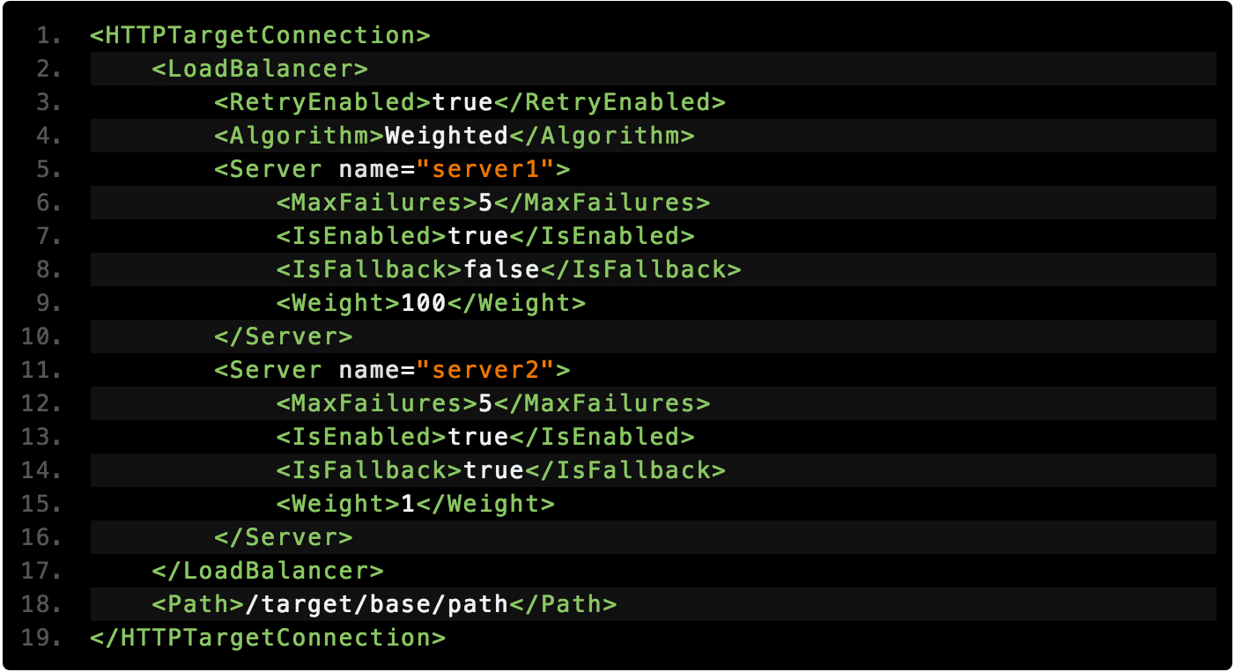
Load Balancer Example

Slide 18
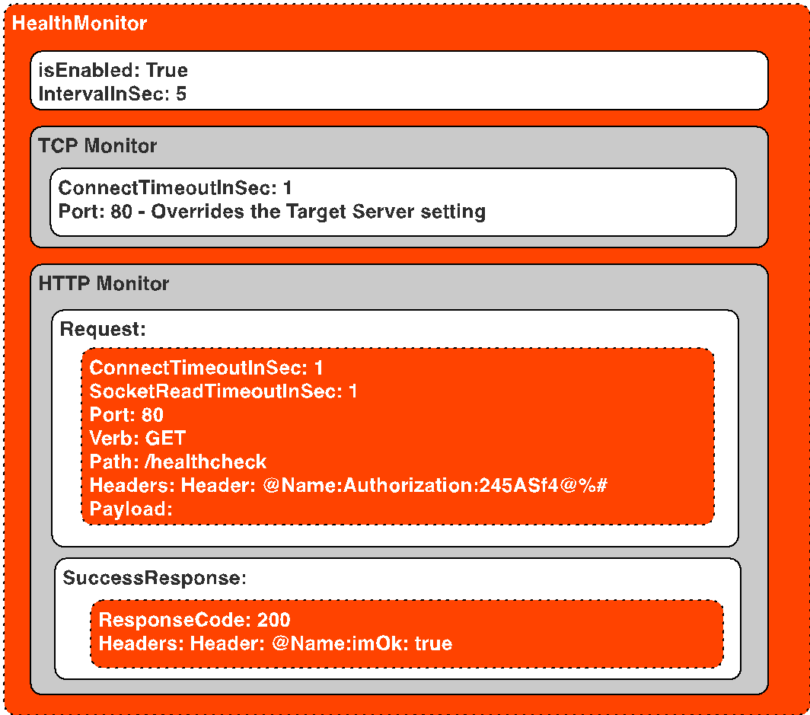
Health Monitor
Notes:
Health monitoring enables you to enhance load balancing configurations by actively polling the backend service URLs defined in the TargetServer configurations. The HealthMonitor acts as a simple client that invokes a backend service over TCP or HTTP. A TCP client simply ensures that a socket can be opened. You configure the HTTP client to submit a valid HTTP request to the backend service. You can define HTTP GET, PUT, POST, or DELETE operations. Typically, you define a simple GET request that simply shows that the backend service is available. You create a HealthMonitor by setting one up in a TargetEndpoint's HTTPConnection configuration. A simple HealthMonitor defines an IntervalInSec combined with either a TCPMonitor or an HTTPMonitor. Note that the port setting overrides the port setting on the target and should only be used if you use a consistent port across all target servers

Slide 19
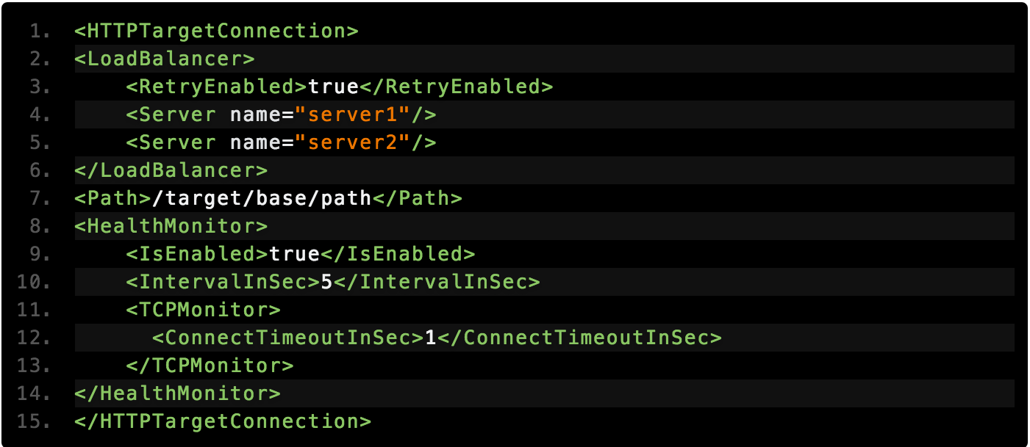
TCP Health Checks

Slide 20
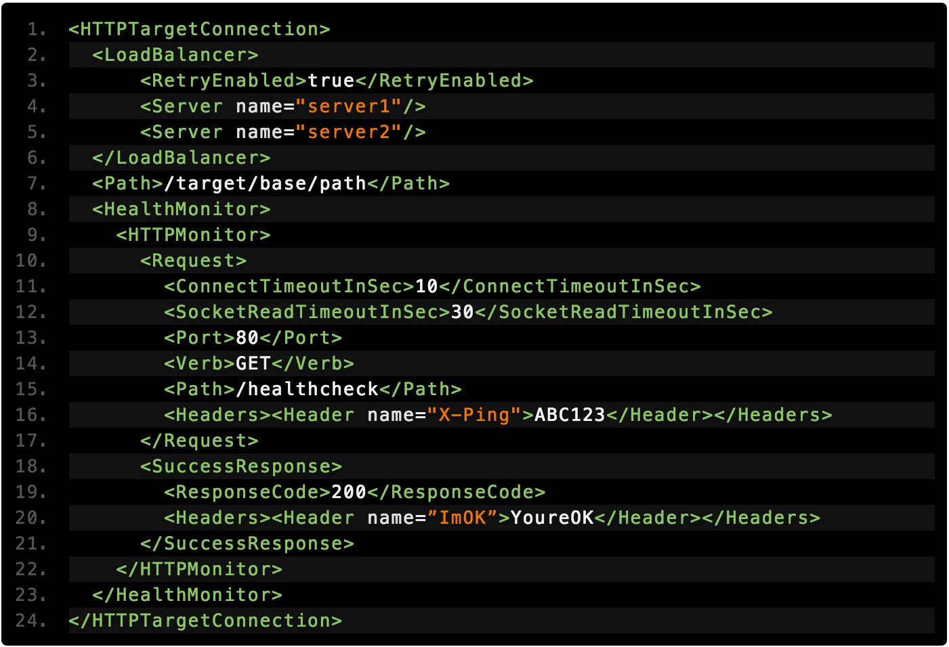
HTTP Health Checks

Slide 21
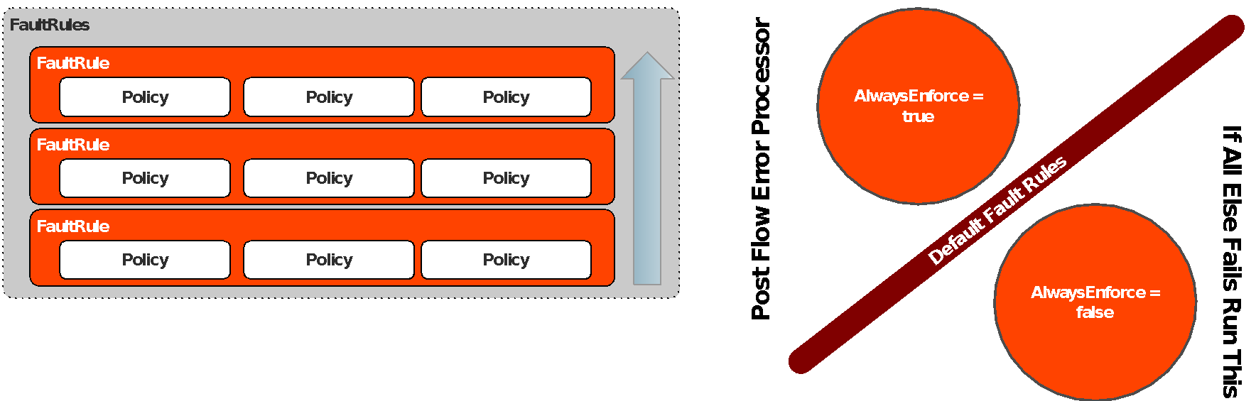
Fault Rules
Notes:
Faults in Edge are similar to exceptions in programming languages. When a fault is raised, current policy processing is aborted and switches to error processing called FaultRulesThis is supported in ProxyEndpoint and TargetEndpoint configurations only Support for multiple fault rules, executed conditionally Raised manually or automatically upon policy failure If multiple conditional FaultRules defined, their conditions are evaluated in reverse order (bottom up). DefaultFaultRule A catch-all / post processing fault rule is available using the flow If no FaultRule is matched, this flow will execute. Use AlwaysEnforce:true to use this flow for post processing in error flows. This will ensure the flow executes after a matched fault rule has completed its processing. 3 scenarios where processing will switch to fault processing: Using RaiseFault policy Any policy failure when contineOnError=false (default setting) Non-success response received from service callout or backend request (4XX, 5XX status codes).

Slide 22
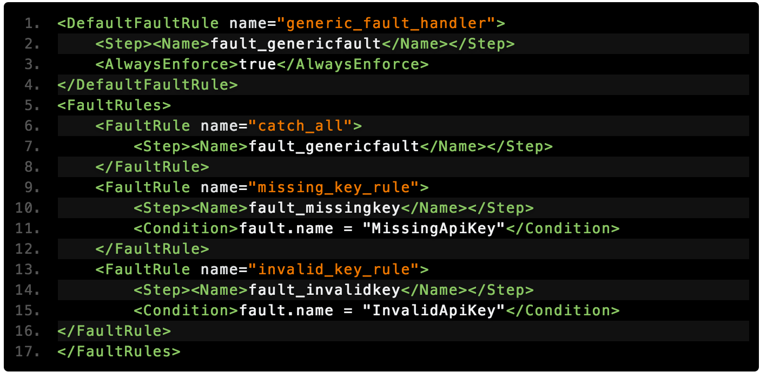
Fault Rules

Slide 23
Advanced Endpoint Properties For Proxy
In addition to the standard endpoint configurations there are some properties to control advanced functionality.
<HTTPProxyConnection>
request.streaming.enabled – if the payload will not be read or updated during the proxy processing, you can enable to to avoid payload buffer size limits
response.streaming.enabled - if the payload will not be read or updated during the proxy processing, you can enable to to avoid payload buffer size limits
Notes:
Allow.http.method may be deprecated

Slide 24
Advanced Endpoint Properties For Target
<HTTPTargetConnection>
connect.timeout.millis – this is used to set the connection timeout for backend connections (in ms). Defaults to 60000 (1 min) and highly recommended to lower
io.timeout.millis – this is used to set the response read timeout (waiting for response from backend). Defaults to 120000 (2 min) and extremely encouraged to reduce to optimize connection handling in the event that a backend service is degraded.
request.streaming.enabled - if the payload will not be read or updated during the target processing, you can enable to avoid payload buffer size limits
response.streaming.enabled - if the payload will not be read or updated during the target processing, you can enable to to avoid payload buffer size limits
success.codes – this property is used to set the response status codes that are treated as ‘success’. Defaults to 1XX,2XX,3XX. This is a helpful configuration when you want to access 4XX responses are success to continue response flow processing

Slide 25
THANK YOU

